Slide 1

RAJIV GANDHI UNIVERSITY OF KNOWLEDGE TECHNOLOGIES - SRIKAKULAM
E3 - CSE
MINI PROJECT FINAL REVIEW
TEAM NUMBER : 84
UNDER THE GUIDANCE OF
MR. G. SHIVA RAMA SASTRY
M.Tech, (Ph.D)
Asst. Professor, CSE.
1. Praveen Kumar Ippili – S180221
2. Manasa Bojja – S180122
3. Bhuvana Sree Jami – S180073

Slide 2
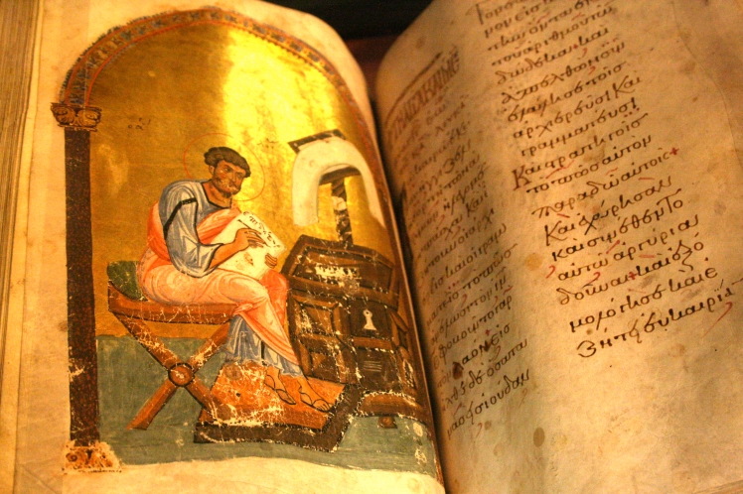
TEXT LINE SEGMENTATION FOR MEDIEVAL MANUSCRIPT

Slide 3
TABLE OF CONTENTS
Abstract
Introduction
01
02
A glance of the project
What is Text line segmentation ?
Why manuscripts ?
Procedure
Conclusion
03
04
Stages
Implementation
Output
Limitations
Proposed Vs. Existed
References

Slide 4
ABSTRACT
Text line segmentation is an essential step in the digitalization of medieval manuscripts. These manuscripts are often written in scripts that vary in size, style, and spacing. This process involves identifying individual lines of text within an image of a manuscript page. It is a challenging task due to noise, degradation, and variations in the manuscript layout and format. In recent years, text line segmentation techniques have advanced, including both traditional image processing-based methods and deep learning-based methods. This project provides an overview of Text line segmentation and it’s performance on medieval manuscript datasets, highlighting the advantages and limitations of the approach. Additionally, this project identifies open research challenges and future directions for text line segmentation for medieval manuscripts.
Keywords: Text line segmentation, Manuscripts, Computer Vision, Image processing, Seam Carving Algorithm.

Slide 5
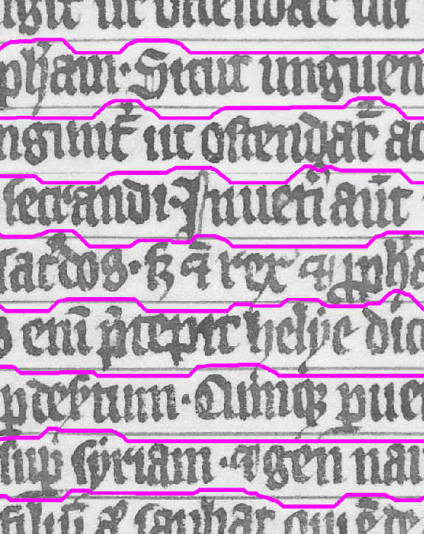
TEXT LINE SEGMENTATION
Text-line segmentation is a crucial part of document image processing and remains mainly unsolved, especially in documents with complex layouts.

Slide 6
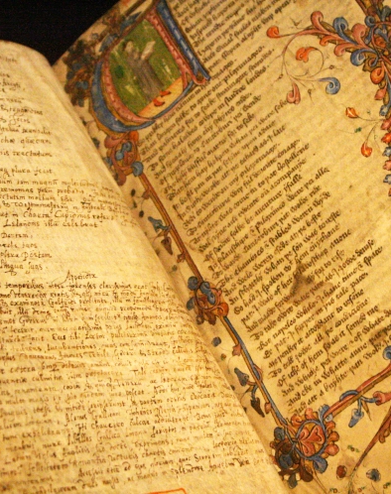
WHY MANUSCRIPTS ?
Medieval manuscripts present unique challenges for text line segmentation due to their age, variability in writing styles, and damage over time.

Slide 7
STAGES IN PROCEDURE
Energy Map
Pixel Intensity
values
01
02
03
Preprocessing
Seam Carving
Loading
Preprocessing
Algorithm for
Removing
Unnecessary things

Slide 8
STAGES IN PROCEDURE
Binning Algorithm
Text Line Sementation
Grouping
Text regions
Implementing
Every step together
04
05
06
Polygon manager
Lining a layout
Around text

Slide 9
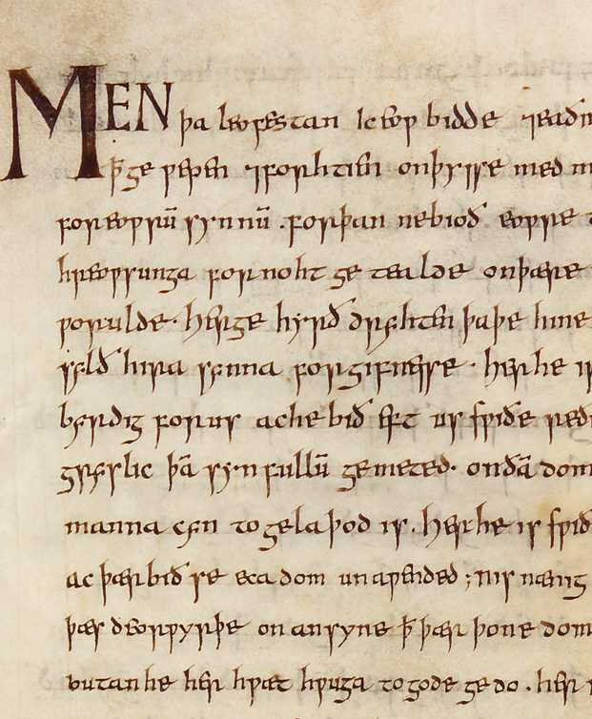
PREPROCESSING
This module likely contains functions for preprocessing the input image, such as filtering, noise removal, and enhancement techniques.

Slide 10
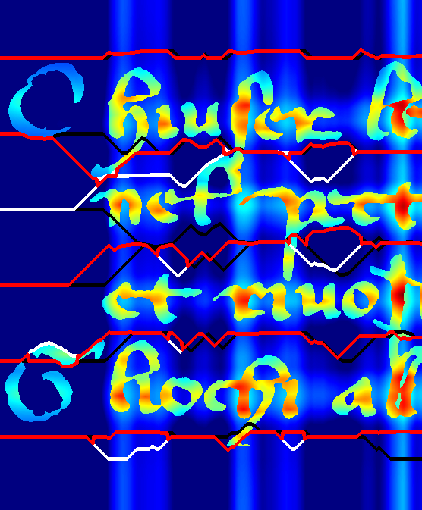
ENERGY MAP
This module is responsible for creating the energy map of the image, which highlights regions of high energy or importance for text line segmentation.

Slide 11
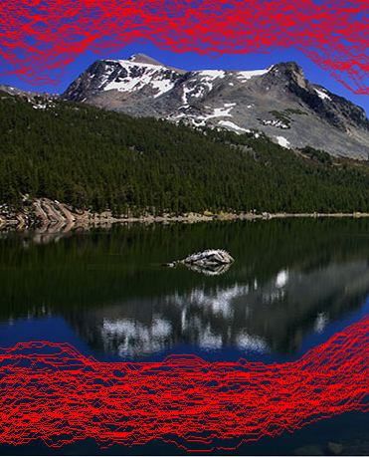
SEAM CARVING
This module implements the seam carving algorithm, which identifies and removes seams (paths of low energy) from the image to resize or reposition the content while preserving the important text regions.

Slide 12
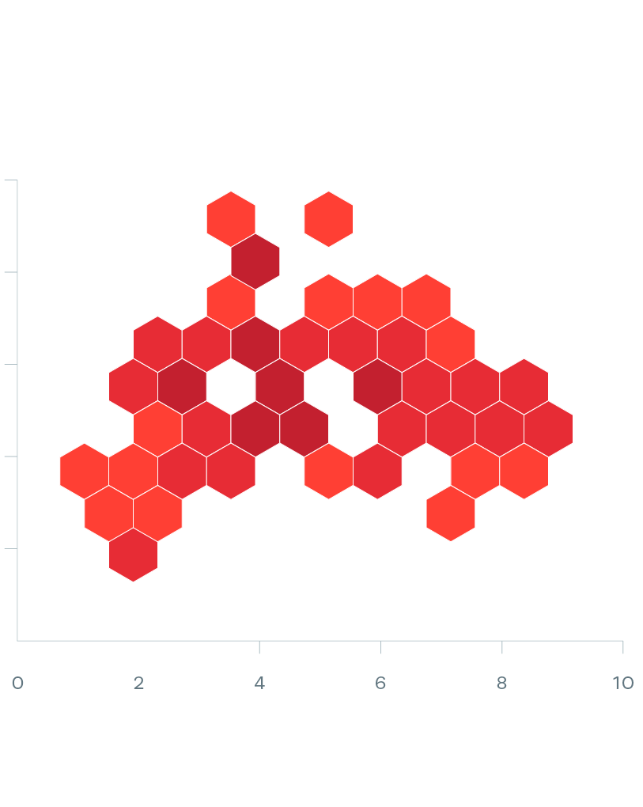
BINNING
This module likely contains the algorithm for dividing the image into bins or clusters based on the presence of text lines, using techniques like majority voting.

Slide 13

POLYGON MANAGER
This module handles the management and manipulation of polygons representing the extracted text lines, such as merging, splitting, or filtering operations.

Slide 14
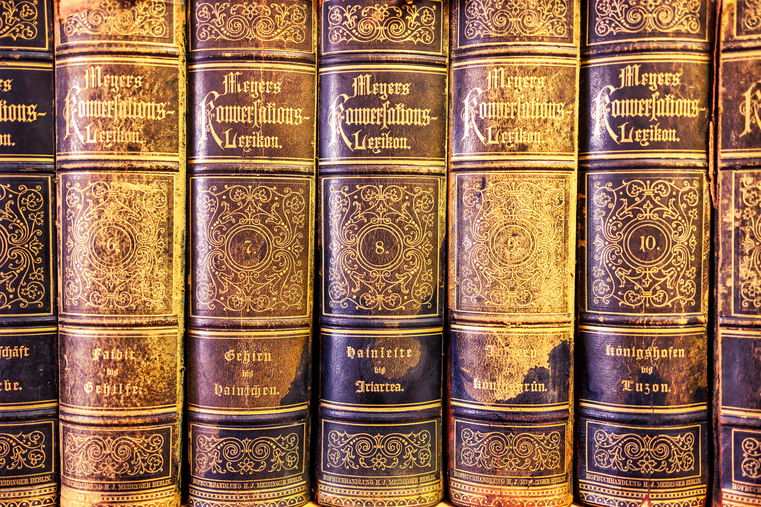
REQUIRED MODULES
XMLhandler: This module deals with reading and writing XML files for storing the results of the text line segmentation process.
Utilis: This module consists of utilities for image loading, visualization, and file handling.
Graph_logger: This module is responsible for visualizing the graphs.

Slide 15
LIMITATIONS
Sensitivity to Image Quality.
Only applicable for given dataset.
Computational Complexity.
Integration Challenges.
Difficulty with Complex Layouts.

Slide 16
EXISTED & PROPOSED SYSTEM
EXISTED SYSTEM | PROPOSED SYSTEM
Use modern text documents as their dataset. | Use images of historical manuscripts.
Often rely on traditional image processing techniques. | Use of Seam Carving algorithm.
Aim to improve the accuracy of OCR systems or assist in document analysis tasks. | Focus on preserving and digitizing historical documents.

Slide 17

EXPECTED RESULT
INPUT
OUTPUT

Slide 18
REFERENCES
DIVA-DIA : https://arxiv.org/abs/1906.11894
Research Gate : www.researchgate.net/2862364
IEEE Paper : www.ieeexplore.ieee.org/6981003

Slide 19
THANK YOU

